Slide 1
Week 6b: Aliasing

Slide 2
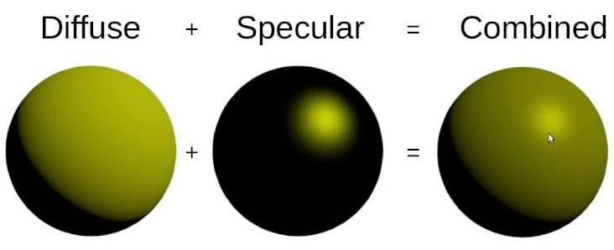
Last class
Blinn Phong
Gooch shading / NPR

Slide 3
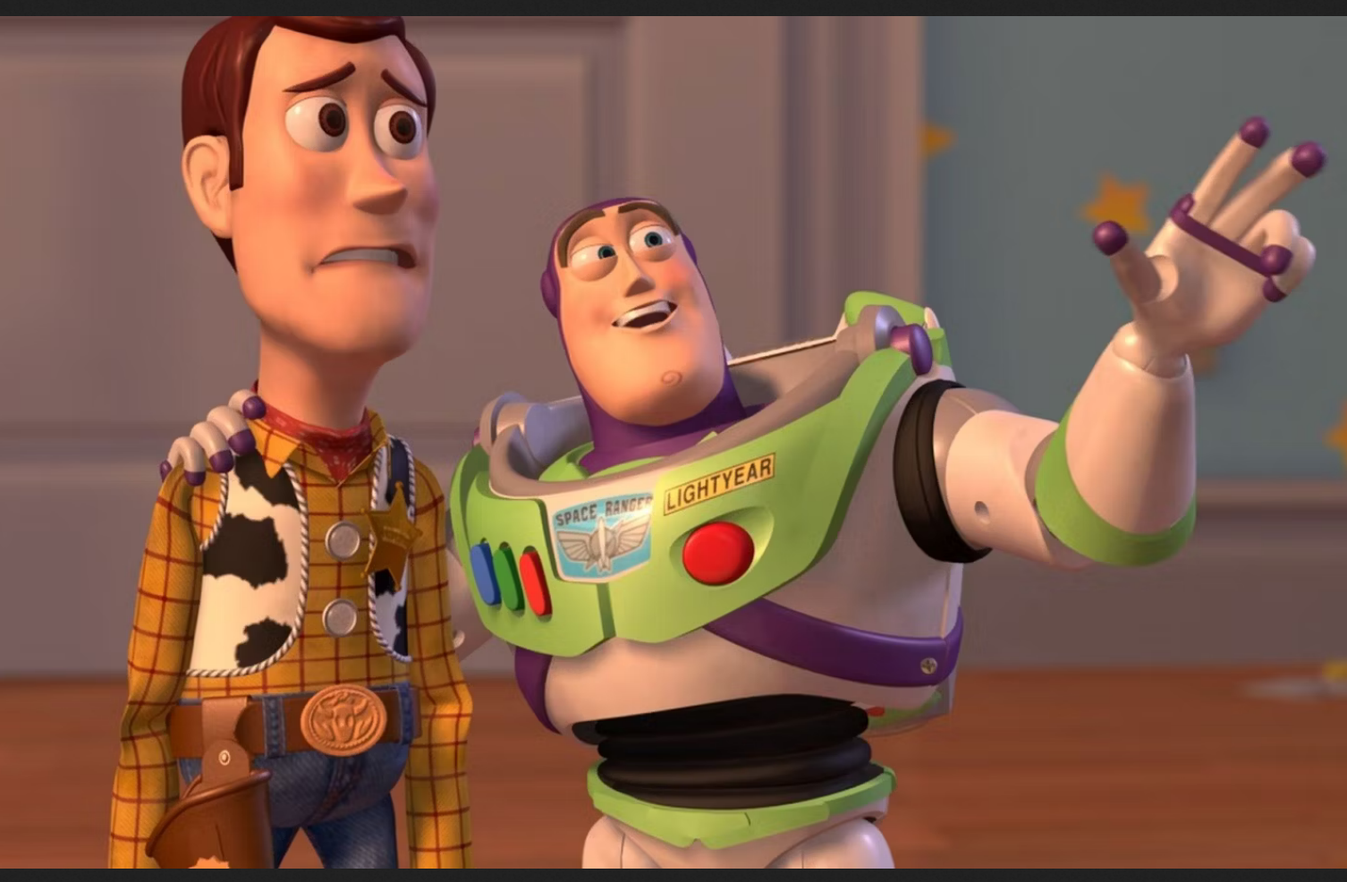
Course schedule
 | Monday | Thursday
Week 1 : 12/02 | Introduction | C#/Unity Lab
Week 2 : 19/02 | 3D reasoning | 3D Lab
Week 3 : 26/02 | Basic Pipeline | Lab
Week 4 : 04/03 | Textures | Normal maps Labs
Week 5 : 11/03 | Post processing | Camera’s Light
Week 6 : 18/03 | Materials | Aliasing Materials Lab
Week 7 : 25/03 | Procedural generation | Procedural generation
Week 8 : 15/04 | Advanced pipeline | Advanced pipeline lab
Week 9 : 22/04 | Project explanation | Project lab
Week 10 : 29/04 | Guest Lecture Project Labs | Guest Lecture Project Labs
Week 11 : | Revision | Revision
Highly likely to change ☹

Slide 4
This class
→ Temporal aliasing←
Aliasing
Anti – Aliasing

Slide 5
Temporal aliasing

Slide 6
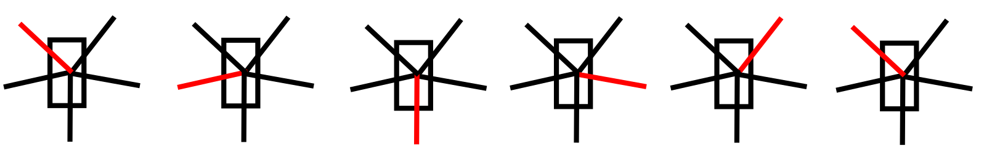
Rotor does rotate over time

Slide 7
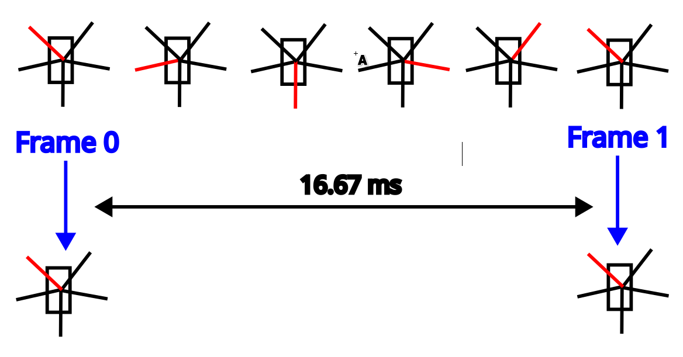
We capture (sample) at different times (and get unlucky)

Slide 8
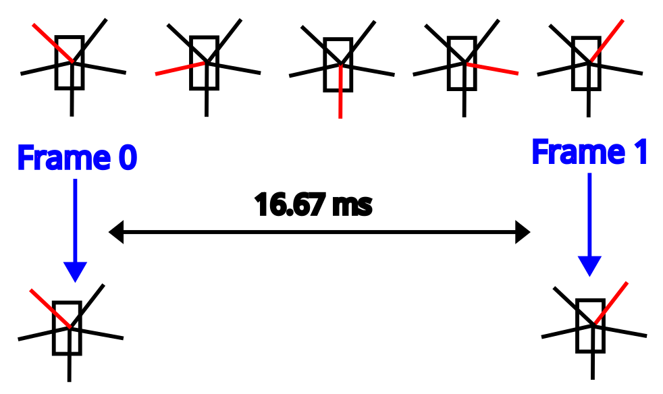
It could appear to go backward as well

Slide 9
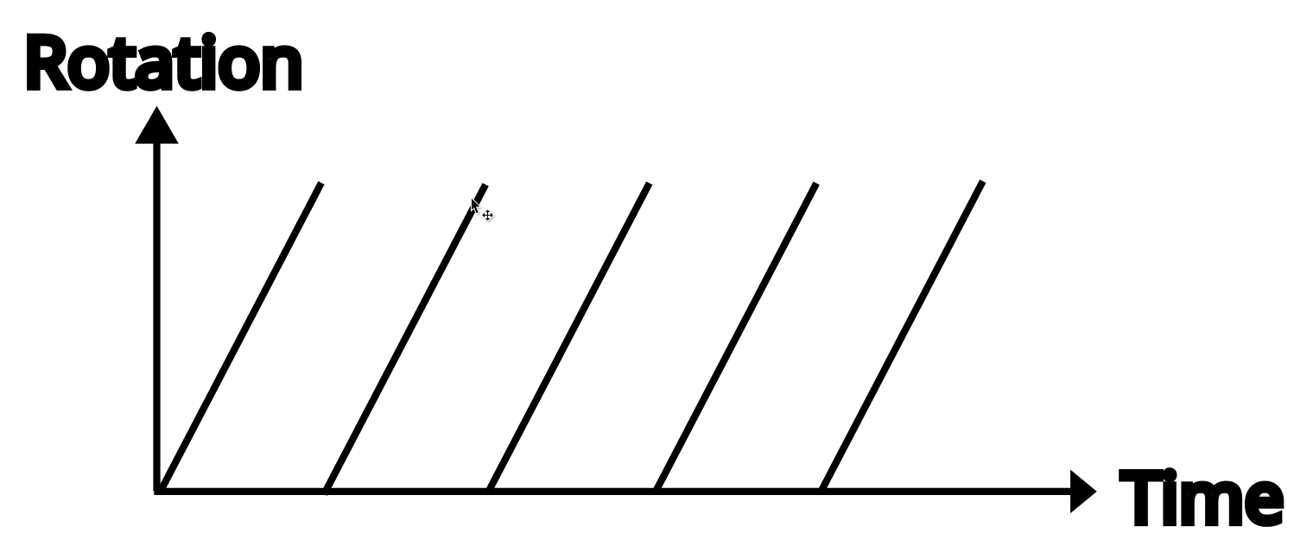
We can draw the rotation as a function of time

Slide 10
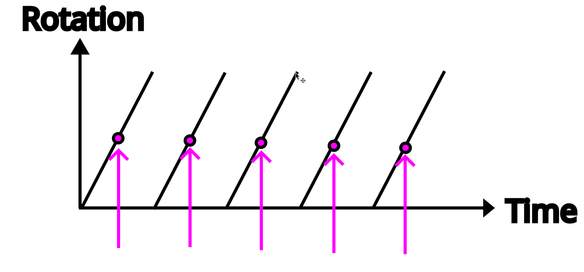
We sample this function (sample = get 1 value)

Slide 11
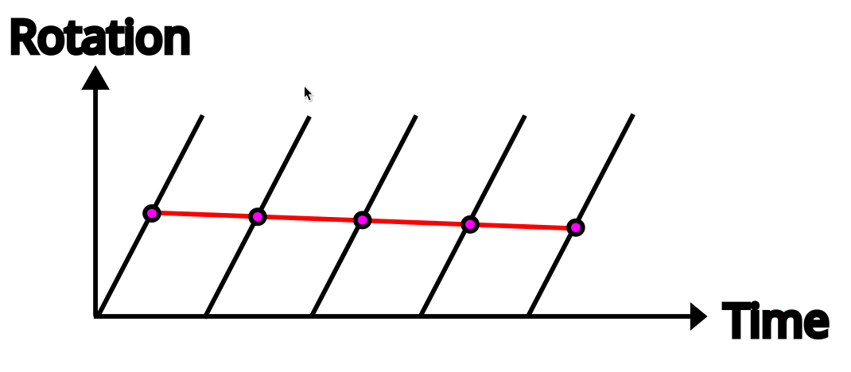
And get a new function (a reconstruction)

Slide 12
And it’s totally wrong!
We don’t take enough samples
We get a function that is aliasing the actual function

Slide 13
This class
Temporal aliasing
→ Aliasing ←
Anti – Aliasing

Slide 14
TODO show other deck

Slide 15
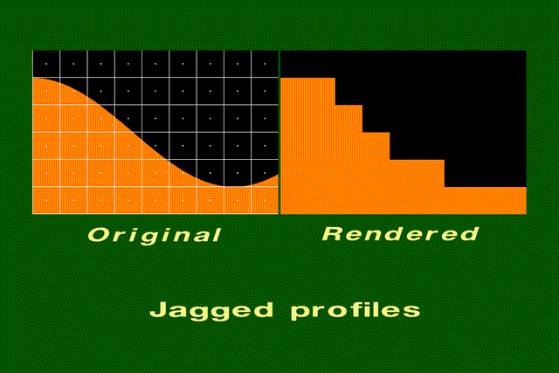
Example of staircasing

Slide 16
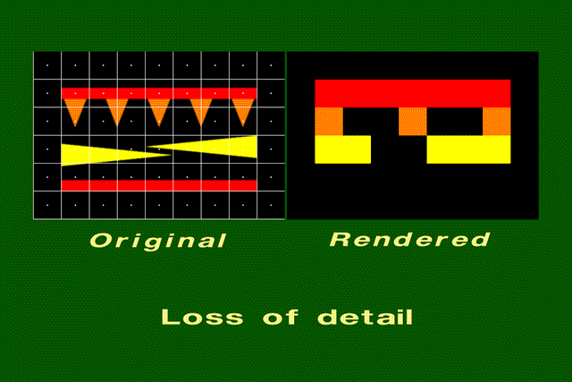
Too much geometric detail

Slide 17
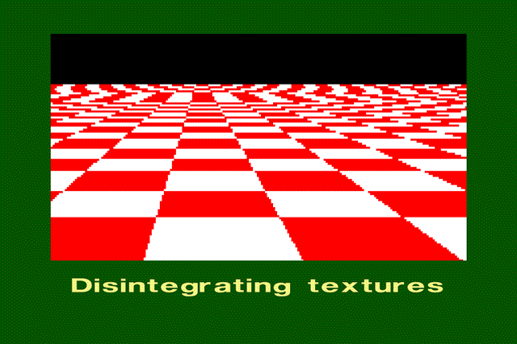
Too much texture detail

Slide 18
This class
Temporal aliasing
Aliasing
→ Anti – Aliasing ←

Slide 19
Anti - Aliasing
Can never remove aliasing completely
Can avoid / remove most of it

Slide 20
Anti - Aliasing
Supersampling
MSAA
FXAA
TAA
LOD’s

Slide 21
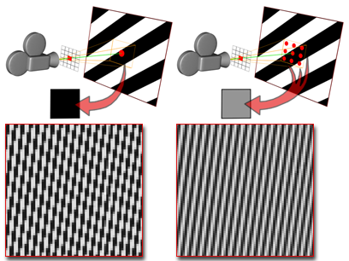
Supersampling
Render at a higher resolution
Downsample to display resolution
Eg display is 1920 x 1080 → render at 3840 x 2160 (4 samples per pixels)
Works very well
Very expensive and wasteful (most pixels don’t need more samples)
Pixar does this (thousands of samples per pixel)

Slide 22
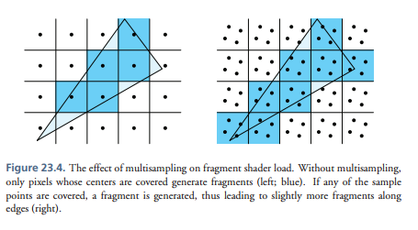
MSAA
Multi sample antialiasing
More samples at the edge of objects
Works well with staircasing
“more samples where we need them”
Fragment shader run for each object!
Doesn’t work with modern pipelines

Slide 23
FXAA
Full screen pass (post process)
Doesn’t avoid aliasing
Tries to hide it
“edge blurrer”
Easy and cheap

Slide 24
TAA
Temporal Anti Aliasing
Gather samples over different frames
Complex : camera moves (have to find previous position of pixel)
Preferred method for AAA games

Slide 25
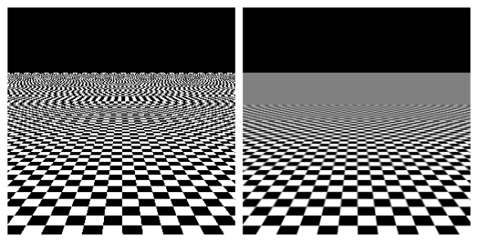
LOD’s

Slide 26
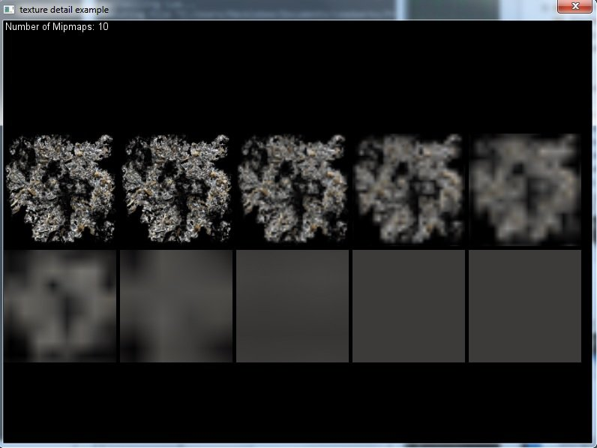
Mipmaps

Slide 27
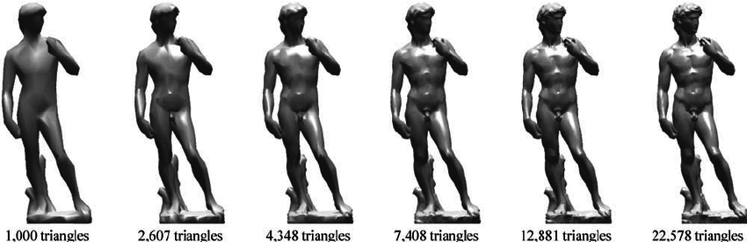
Mesh LOD’s

Slide 28
Recap
Aliasing happens when you have too much detail (geometry, texture, shader) for your resolution
Mipmapping, fxaa, taa can help
LOD is very important

Slide 29
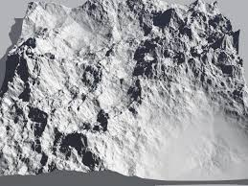
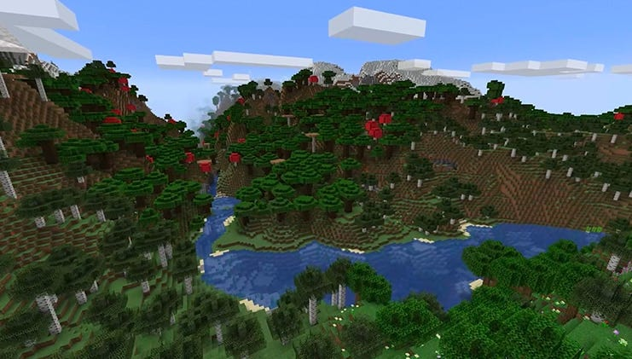
Next class
Procedural generation

